Slide 1


Slide 2

Financial Markets Vs Macro-Economic Indicators of USA
Capstone Project 1 – Group 9

Slide 3
Meet the Team

Slide 4





Meet the Team
Santhosh
Narapareddy
Rituraj
Borah
Vidya
Biradar
Bhavita
Bhatt
Sai Ganesh
Darisa

Slide 5
INTRODUCTION

Slide 6
INTRODUCTION
In our everyday conversations, we often overlook fundamental economic drivers due to lack of financial data literacy and awareness, leading to a knowledge gap.
Notes:
Intro – Overlook about fundamental economic drivers and lack of financial data literacy

Slide 7
INTRODUCTION
In our everyday conversations, we often overlook fundamental economic drivers due to lack of financial data literacy and awareness, leading to a knowledge gap.
Our objective is to create a data-driven solution for addressing this knowledge gap by focusing on essential economic indicators such as GDP, inflation (CPI), and unemployment rates.

Slide 8
INTRODUCTION
In our everyday conversations, we often overlook fundamental economic drivers due to lack of financial data literacy and awareness, leading to a knowledge gap.
Our objective is to create a data-driven solution for addressing this knowledge gap by focusing on essential economic indicators such as GDP, inflation (CPI), and unemployment rates.
Our project also covers various data related to financial markets, including capital, debt, cryptocurrencies, and commodities.

Slide 9
INTRODUCTION
In our everyday conversations, we often overlook fundamental economic drivers due to lack of financial data literacy and awareness, leading to a knowledge gap.
Our objective is to create a data-driven solution for addressing this knowledge gap by focusing on essential economic indicators such as GDP, inflation (CPI), and unemployment rates.
Our project also covers various data related to financial markets, including capital, debt, cryptocurrencies, and commodities.
Through this project, we aim to bridge the gap between the everyday discussions related on economic data and financial markets and the underlying fundamental drivers that shape these conversations.

Slide 10
INTRODUCTION
In our everyday conversations, we often overlook fundamental economic drivers due to lack of financial data literacy and awareness, leading to a knowledge gap.
Our objective is to create a data-driven solution for addressing this knowledge gap by focusing on essential economic indicators such as GDP, inflation (CPI), and unemployment rates.
Our project also covers various data related to financial markets, including capital, debt, cryptocurrencies, and commodities.
Through this project, we aim to bridge the gap between the everyday discussions related on economic data and financial markets and the underlying fundamental drivers that shape these conversations.
We also aim to create financial data awareness and their sources.

Slide 11
Research Questions
Problem Statement
CAPSTONE 1

Slide 12
Research Questions
Problem Statement
CAPSTONE 1
Absolute Trends for
Macro-Economic Indicators (GDP, CPI, Unemployment Rate, etc.)
Financial Market data (US Indices, Commodities and crypto currency)
Key/Significant Events Analysis for
Macro-Economic indicators (GDP, CPI, Unemployment Rate, etc.)
Financial Market data (US Indices, Commodities and crypto currency)
Correlation between
Macro-Economic Indicators
Financial Market instruments
Dashboards

Slide 13
Research Questions
Problem Statement
CAPSTONE 2
[Planned]

Slide 14
Research Questions
Problem Statement
CAPSTONE 2
[Planned]
Correlation between Highly Correlated pairs from
Macro-Economic Indicators
Financial Market instruments
Sectorial Analysis for S&P 500 – Major US indices
Time Series forecasting
Sentiment Analysis of stock news

Slide 15
DATASET INFORMATION

Slide 16


DATASET INFORMATION

Slide 17




DATASET INFORMATION
AlphaVantage
Yahoo Finance

Slide 18
DATASET INFORMATION
AlphaVantage
Yahoo Finance
Macro-Economic Data
Financial Data

Slide 19
TOOLS
Macro-Economic Data
Financial Data
Jupyter Notebook
MS Excel
Tableau

Slide 20
Survey Findings

Slide 21
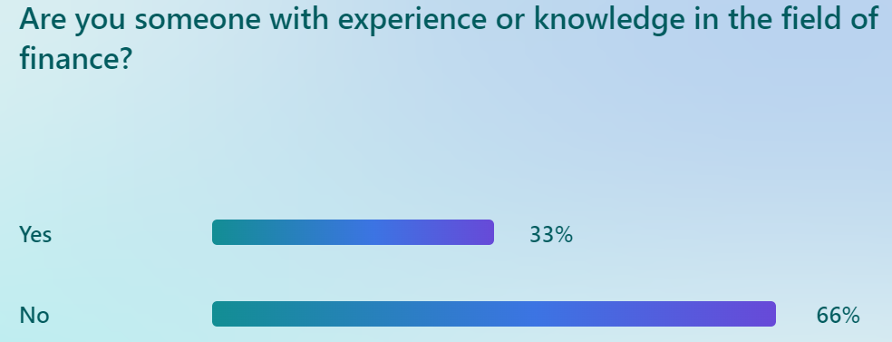
Survey Findings
Majority of the respondents are not from finance field.

Slide 22
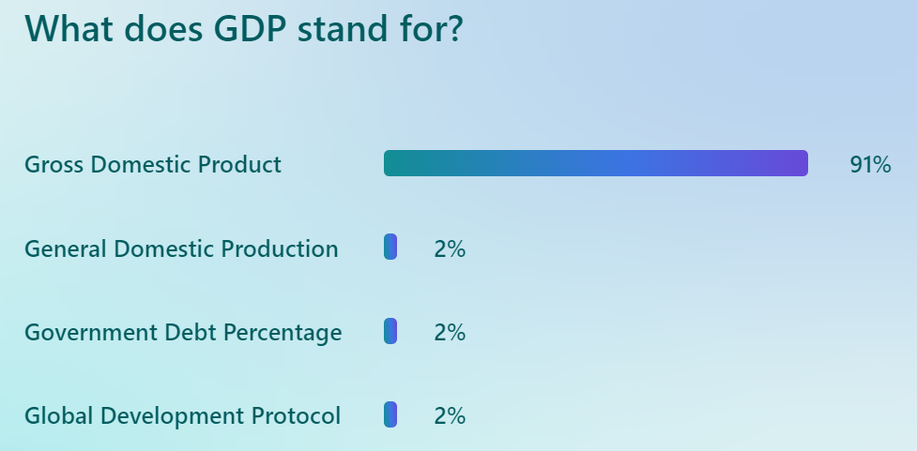
Survey Findings

Slide 23
Survey Findings

Slide 24
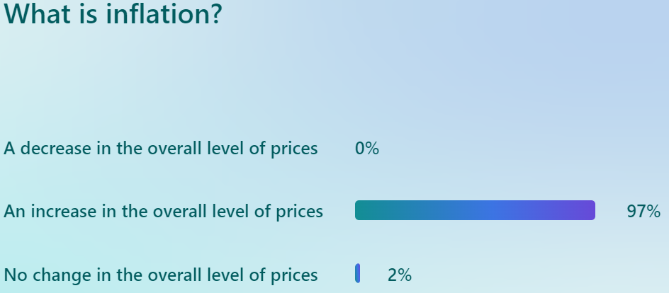
Survey Findings

Slide 25
Survey Findings

Slide 26
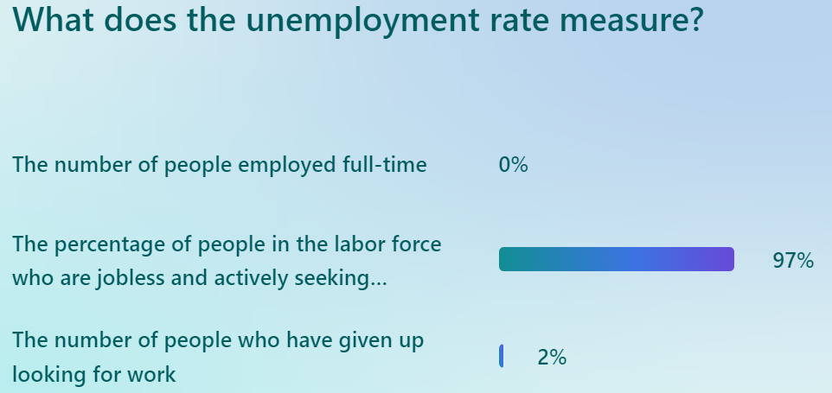
Survey Findings

Slide 27
Survey Findings

Slide 28
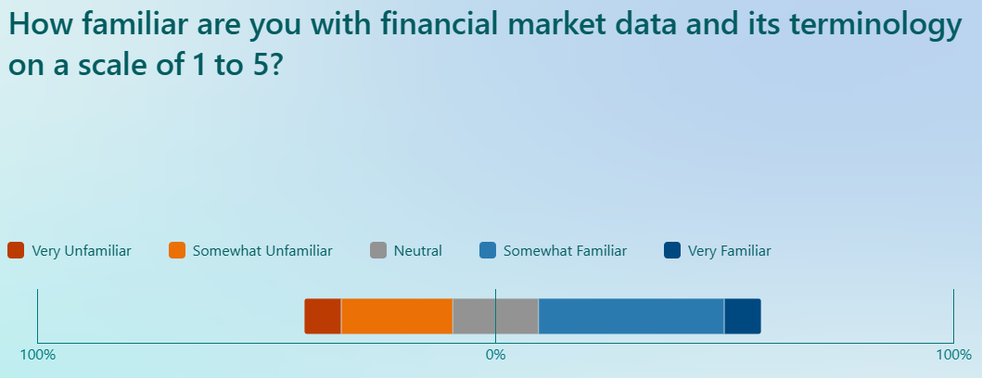
Survey Findings
Good part of our respondents are not familiar with financial market data

Slide 29
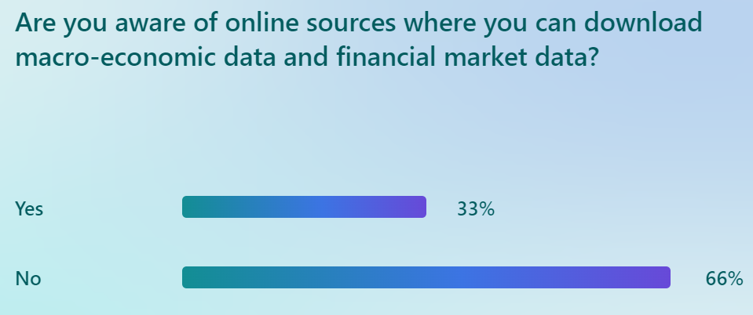
Survey Findings

Slide 30
DASHBOARDS

Slide 31
DASHBOARD
MACROECONOMIC INDICATORS

Slide 32
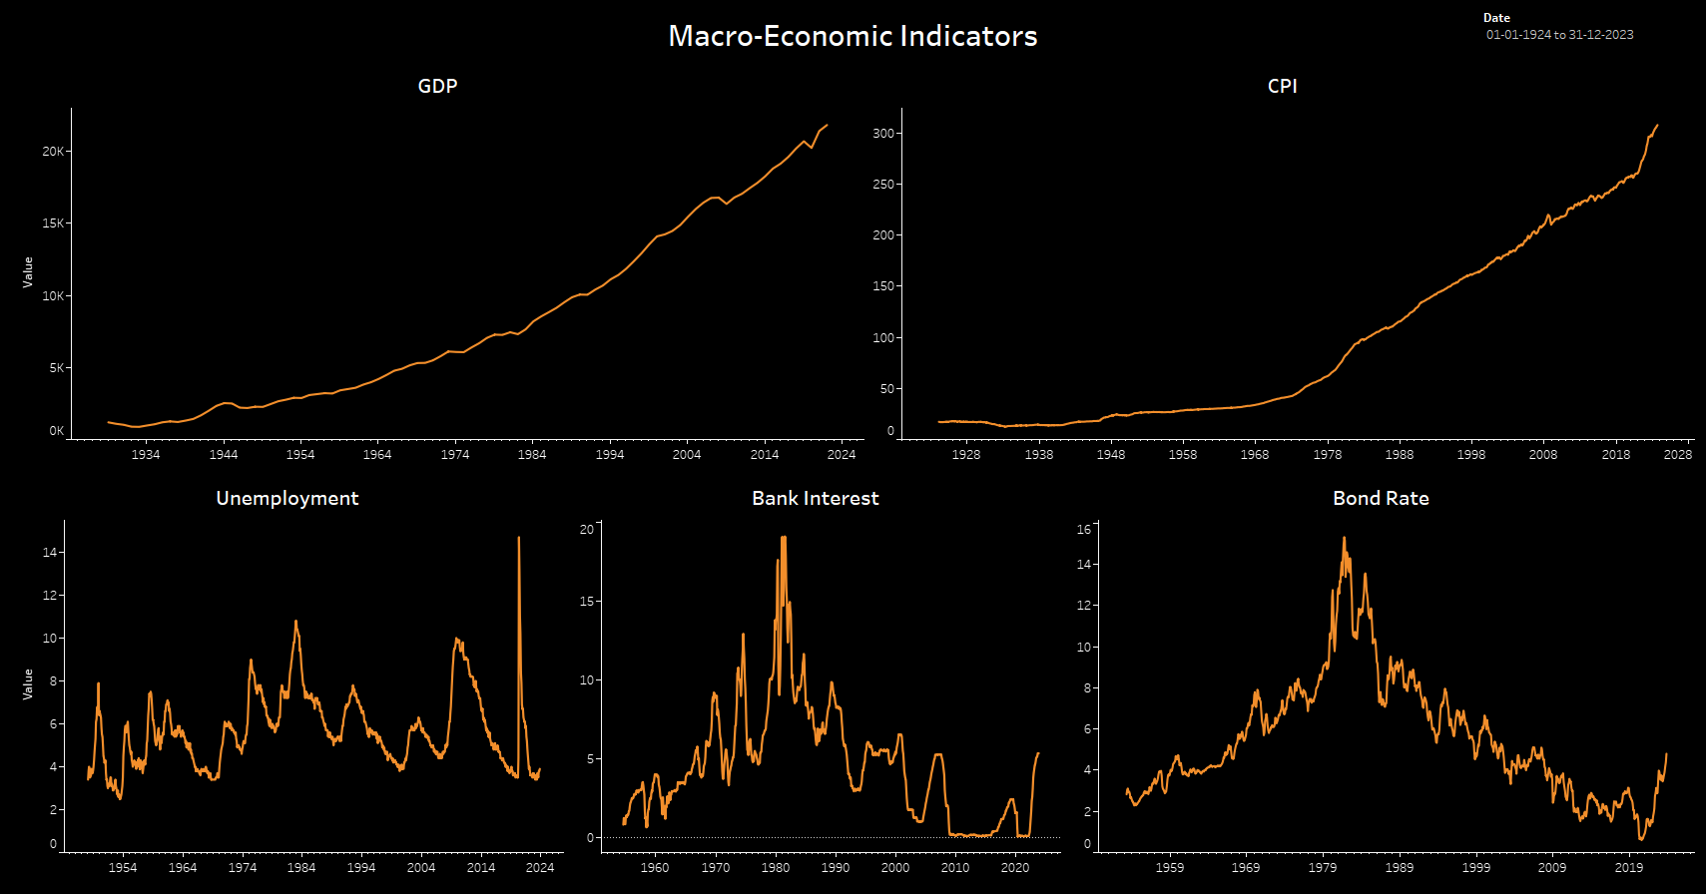
DASHBOARD
MACROECONOMIC INDICATORS

Slide 33
DASHBOARD
US STOCK INDICES

Slide 34
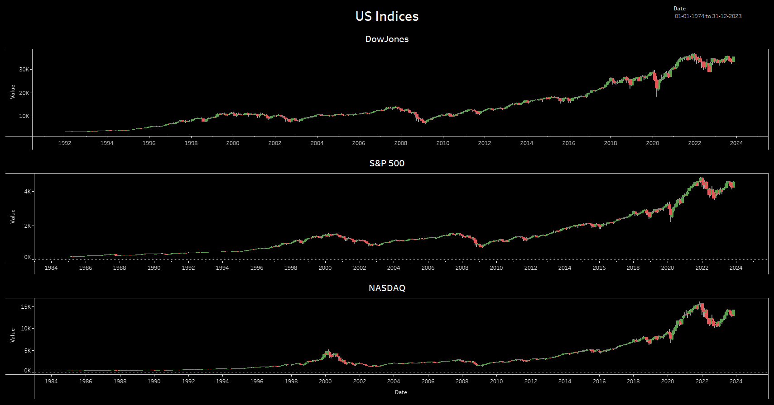
DASHBOARD
US STOCK INDICES
Notes:
2000 Dot Com Bubble
2007-2008 – Financial crisis and housing market bubble

Slide 35
DASHBOARD
COMMODITIES

Slide 36
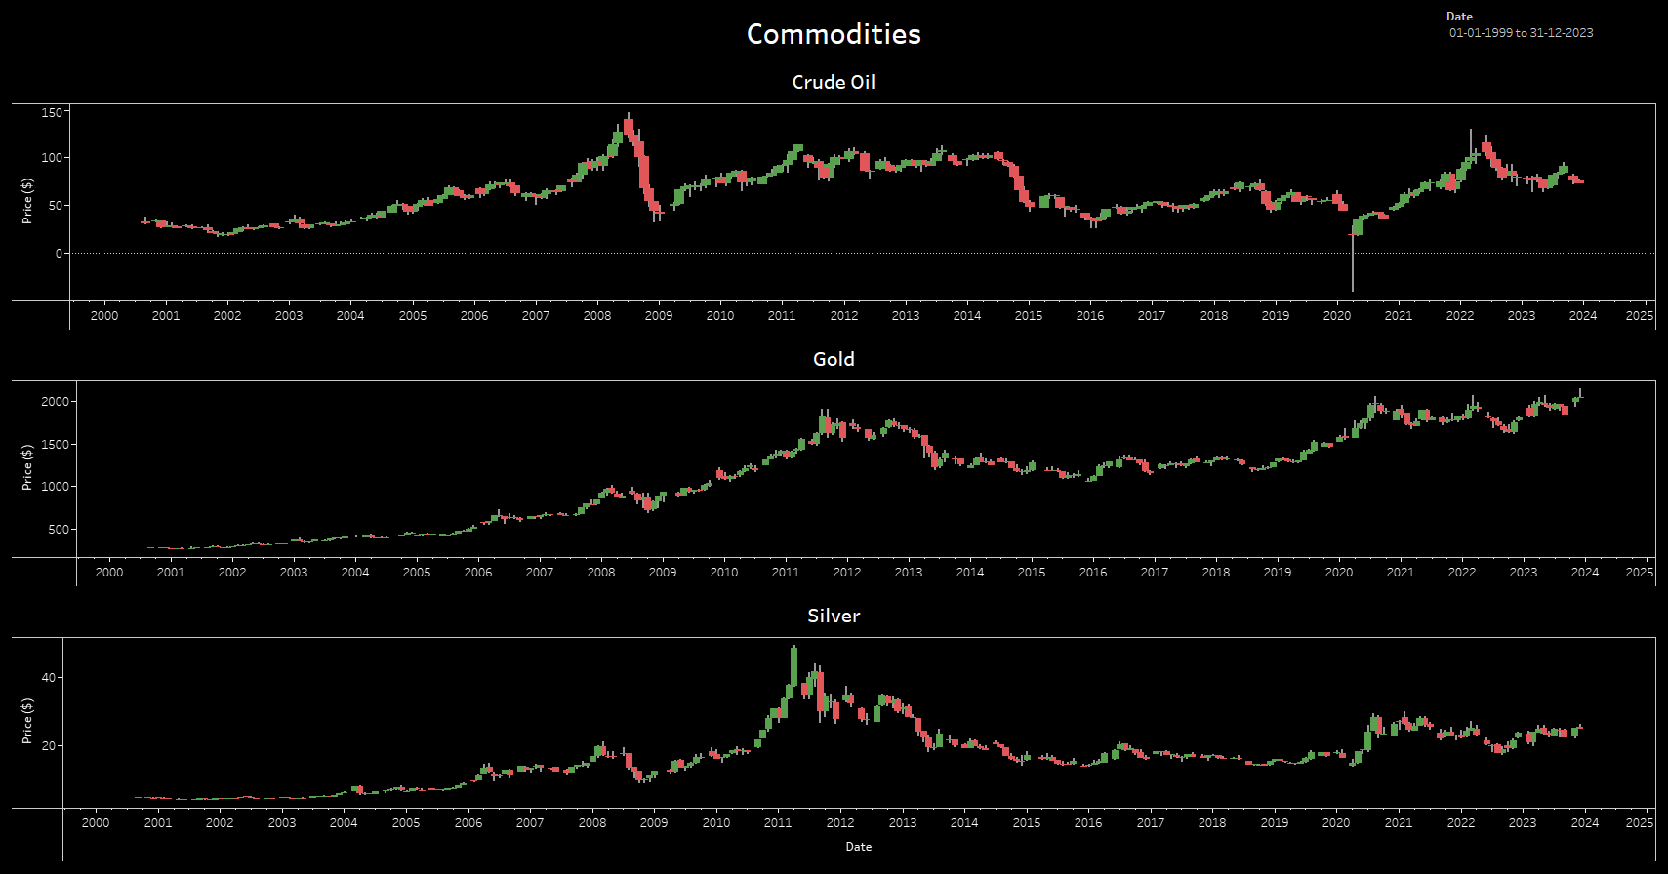
DASHBOARD
COMMODITIES
Notes:
Alternative to equity as diversification

Slide 37
DASHBOARD
CRYPTO CURRENCY

Slide 38
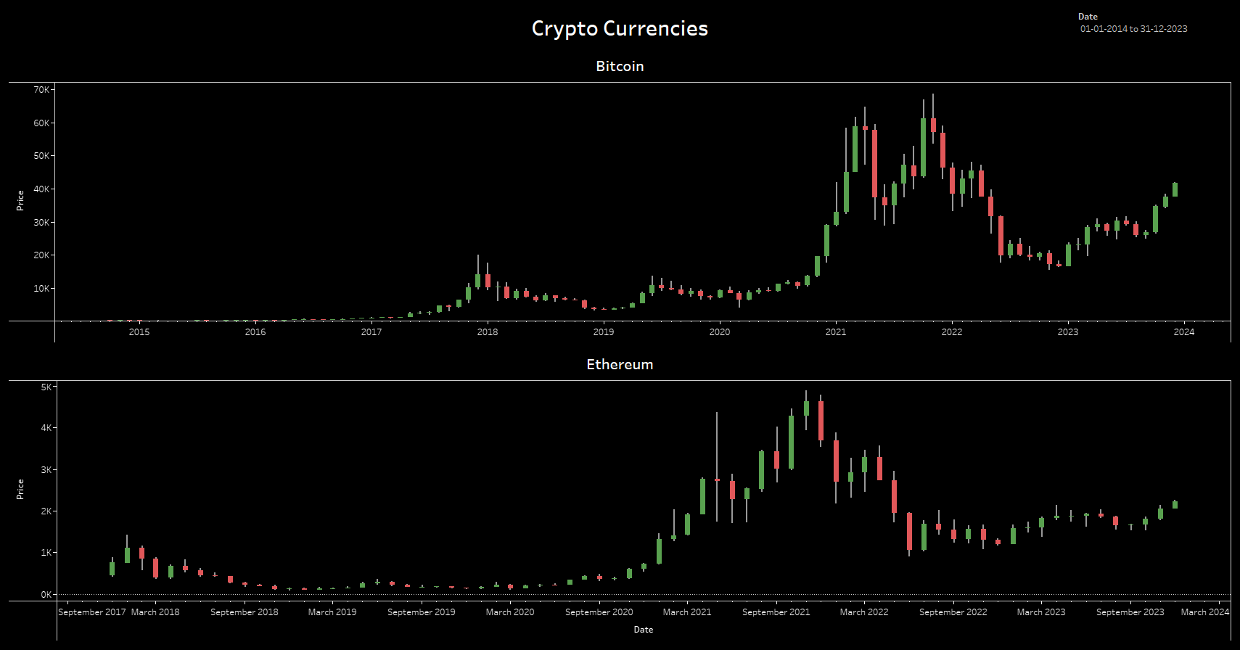
DASHBOARD
CRYPTO CURRENCY

Slide 39
INSIGHTS

Slide 40

INSIGHTS
C
O
R
R
E
L
A
T
I
O
N
MATRIX

Slide 41
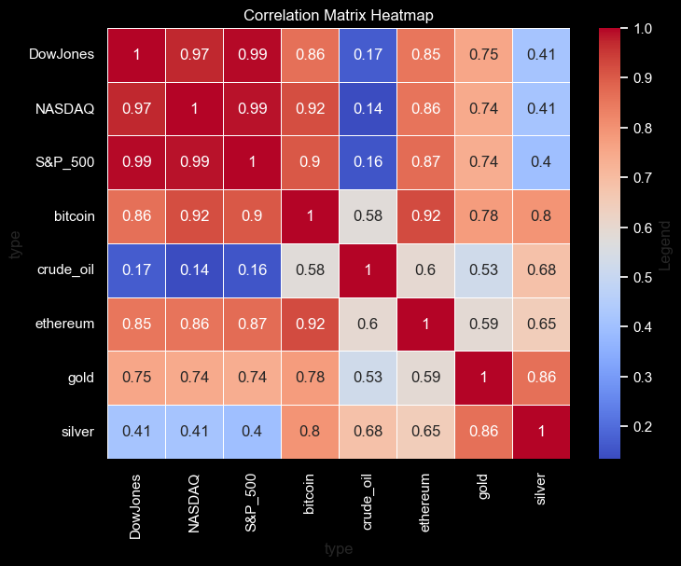
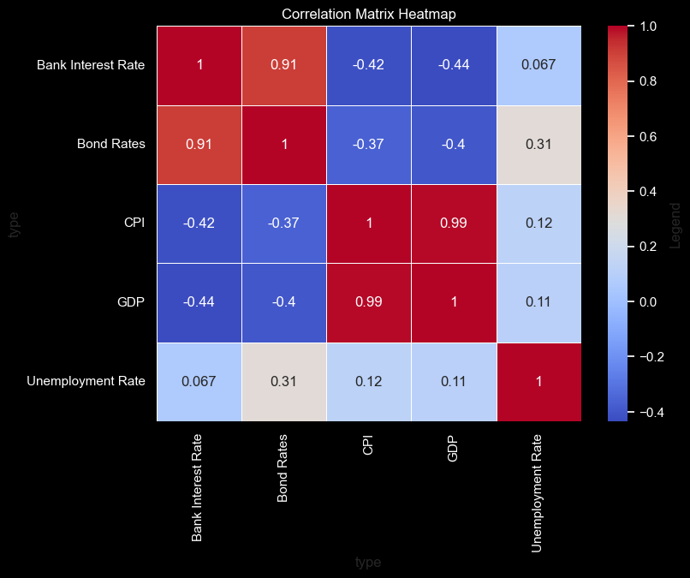
INSIGHTS
C
O
R
R
E
L
A
T
I
O
N
MATRIX

Slide 42
INSIGHTS
C
O
R
R
E
L
A
T
I
O
N
MATRIX
The Dow Jones, NASDAQ, and S&P 500 are highly correlated, indicating similar market movement trends

Slide 43
INSIGHTS
C
O
R
R
E
L
A
T
I
O
N
MATRIX
Bitcoin and Ethereum are strongly correlated with each other and relatively moderate with stock indices, suggesting a partial integration with traditional markets.

Slide 44
INSIGHTS
C
O
R
R
E
L
A
T
I
O
N
MATRIX
Gold has a lower correlation with stocks than bitcoin, hinting at its potential as a diversification asset
Silver shows a high correlation with gold and varying lower correlations with other assets

Slide 45
INSIGHTS
C
O
R
R
E
L
A
T
I
O
N
MATRIX
Macro-Economic Indicators

Slide 46
INSIGHTS
C
O
R
R
E
L
A
T
I
O
N
MATRIX
Bank Interest Rates and Bond Rates are strongly positively correlated, indicating they often move in tandem.
On the other hand, they are negatively correlated with Consumer Price Index (CPI) and Gross Domestic Product (GDP), suggesting that as rates increase, there may be downward pressure on prices and economic output

Slide 47
INSIGHTS
C
O
R
R
E
L
A
T
I
O
N
MATRIX
CPI and GDP are almost perfectly correlated, which may indicate that periods of economic growth are associated with increased inflation.

Slide 48
INSIGHTS
C
O
R
R
E
L
A
T
I
O
N
MATRIX
Unemployment Rate shows a very weak correlation with all other variables, implying it doesn't move strongly in sync with interest rates, inflation, or GDP.
The unemployment rate's weak correlations imply it's influenced by diverse factors beyond economic indicators, such as technology, globalization, policies, and education.

Slide 49
CHALLENGES
/
RECOMMENDATIONS

Slide 50
CHALLENGES
/
RECOMMENDATIONS
DATA
Availability
Complexity
Variability

Slide 51
CHALLENGES
/
RECOMMENDATIONS
DATA
Availability
Complexity
Variability

Slide 52
CHALLENGES
/
RECOMMENDATIONS
TIME Availability TimeLine
DATA
Availability
Complexity
Variability

Slide 53
CHALLENGES
/
RECOMMENDATIONS
TIME Availability TimeLine
DOMAIN
Knowledge Expertise
DATA
Availability
Complexity
Variability

Slide 54
CHALLENGES
/
RECOMMENDATIONS
TIME Availability TimeLine
DOMAIN
Knowledge Expertise
DATA
Availability
Complexity
Variability
BUDGET

Slide 55
FUTURE WORK

Slide 56
FUTURE WORK
Automation of data download
Hosting data on cloud database
Accessing cloud data on Tableau
Implementation of Machine Learning Models
Implementation of Live Dashboards

Slide 57
THANK YOU

